Slide 1
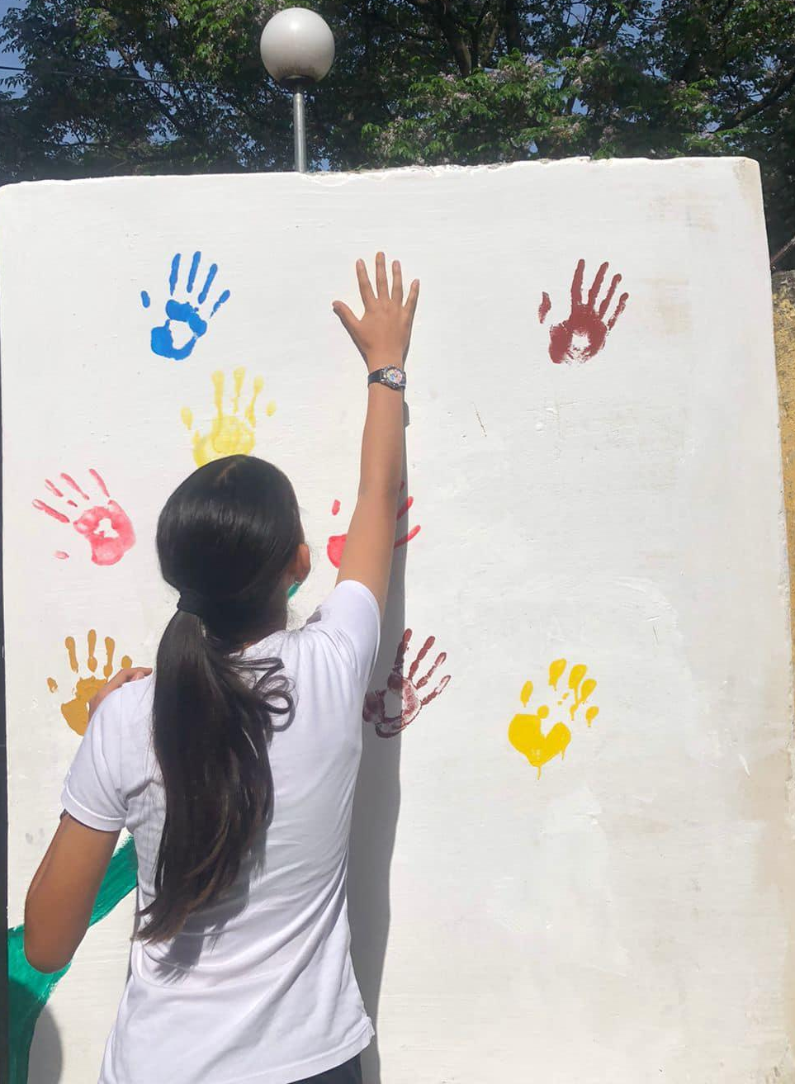
September 2023 Mary Ward Loreto Foundation
Loreto College Manchester
√√
Freedom, Justice Sincerity

Slide 2
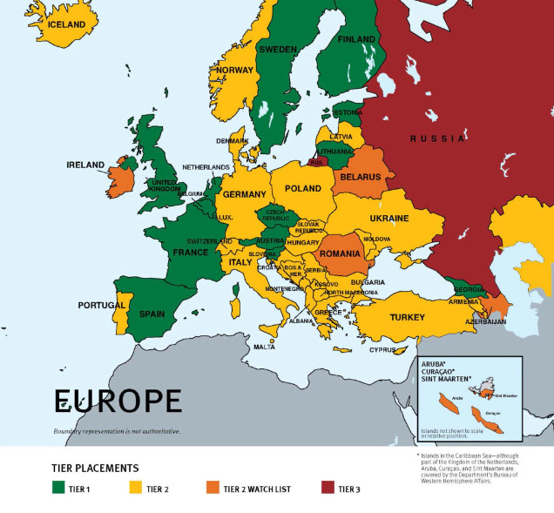
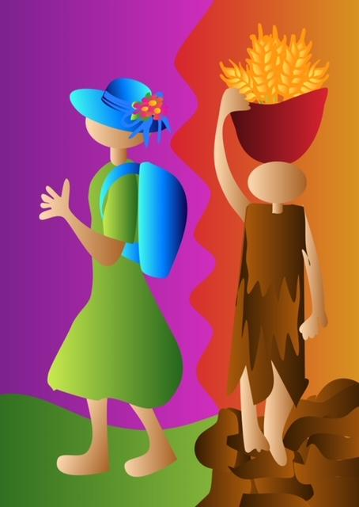
The Reality - Human Trafficking Across Europe: TIP 2021
Imelda Poole IBVM

Slide 3
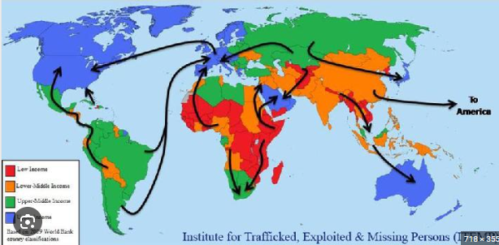

Slide 4
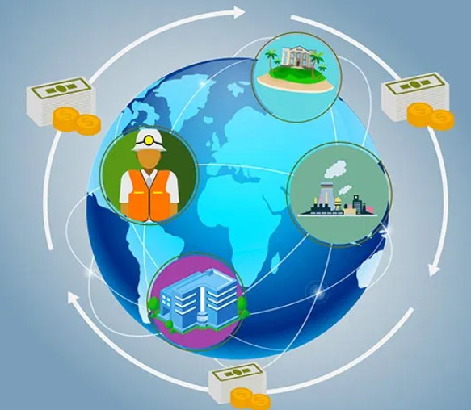

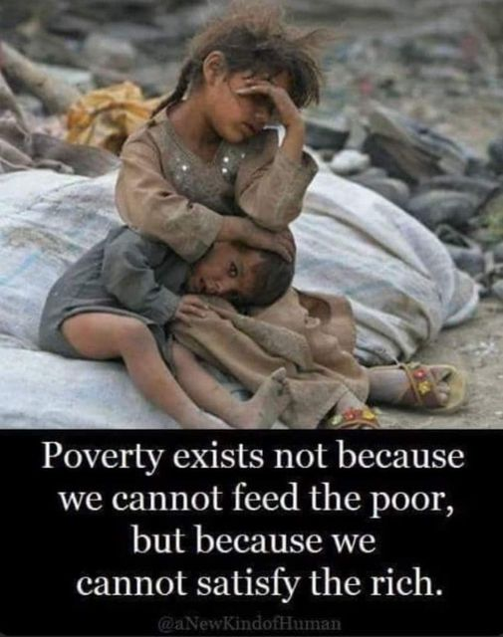
Global Issues
Unfair Economy
Greed
Poverty
Unemployment
Migration and Mobility
Demand
Climate Change
Law
Corruption
Child Exploitation
Covid 19
Ukraine War

Slide 5
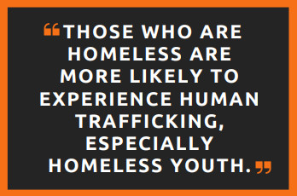
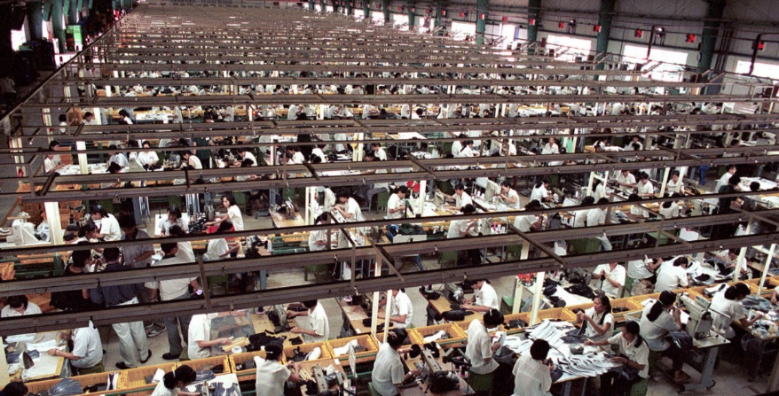
Estimated 80 million Human Trafficked: exploited for labour including sexual exploitation
15.4 million+: in forced marriage
5.4 victims for every 1,000
Global Issues
REMEMBER:
Only 0.9 % of trafficked victims are identified.
Only 0.09% of Traffickers are prosecuted.

Slide 6
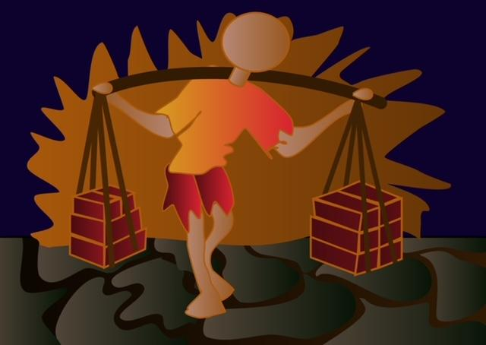
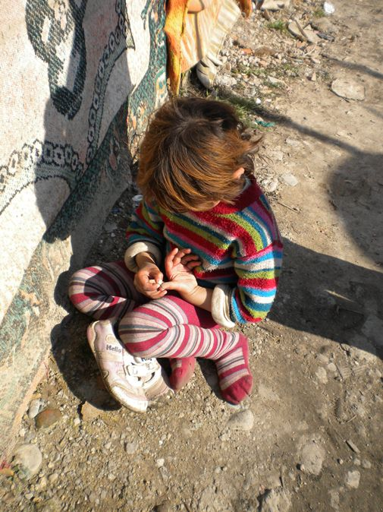
Human Trafficked Victims in the World? Some Data...
Estimated Identified Victims in 2017 - 2018: 50 million
Estimated Identified Victims in 2022: 80 million
According to UN figures:
2022: approx 40% are in the OSCE Region.
War in Ukraine has escalated this risk
Globally Highest number of HT Victims: Asia
Only 0.9 % of trafficked victims are identified.
Only 0.09% of Traffickers are prosecuted.
(Figures researched by OSCE, 2022)

Slide 7
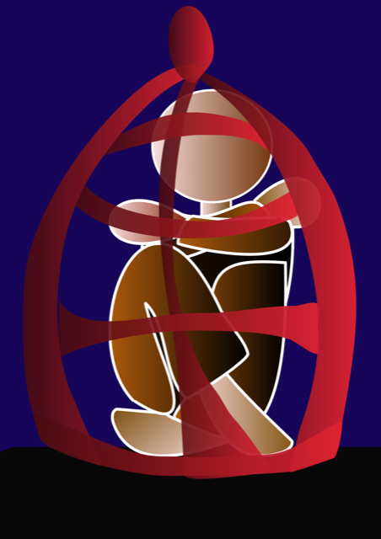
New: IT used by Traffickers Since Covid 19 Pandemic
Traffickers explode their trade on the internet
Algorithms expose the most vulnerable
125% recruitment increase through FB.
95% increase through Instagram
Trafficked Porn in ‘CLOUD’ applications eg Dropbox

Slide 8
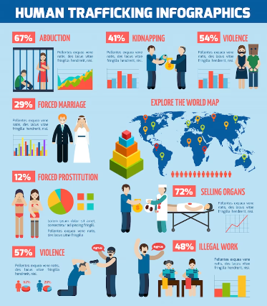

Slide 9
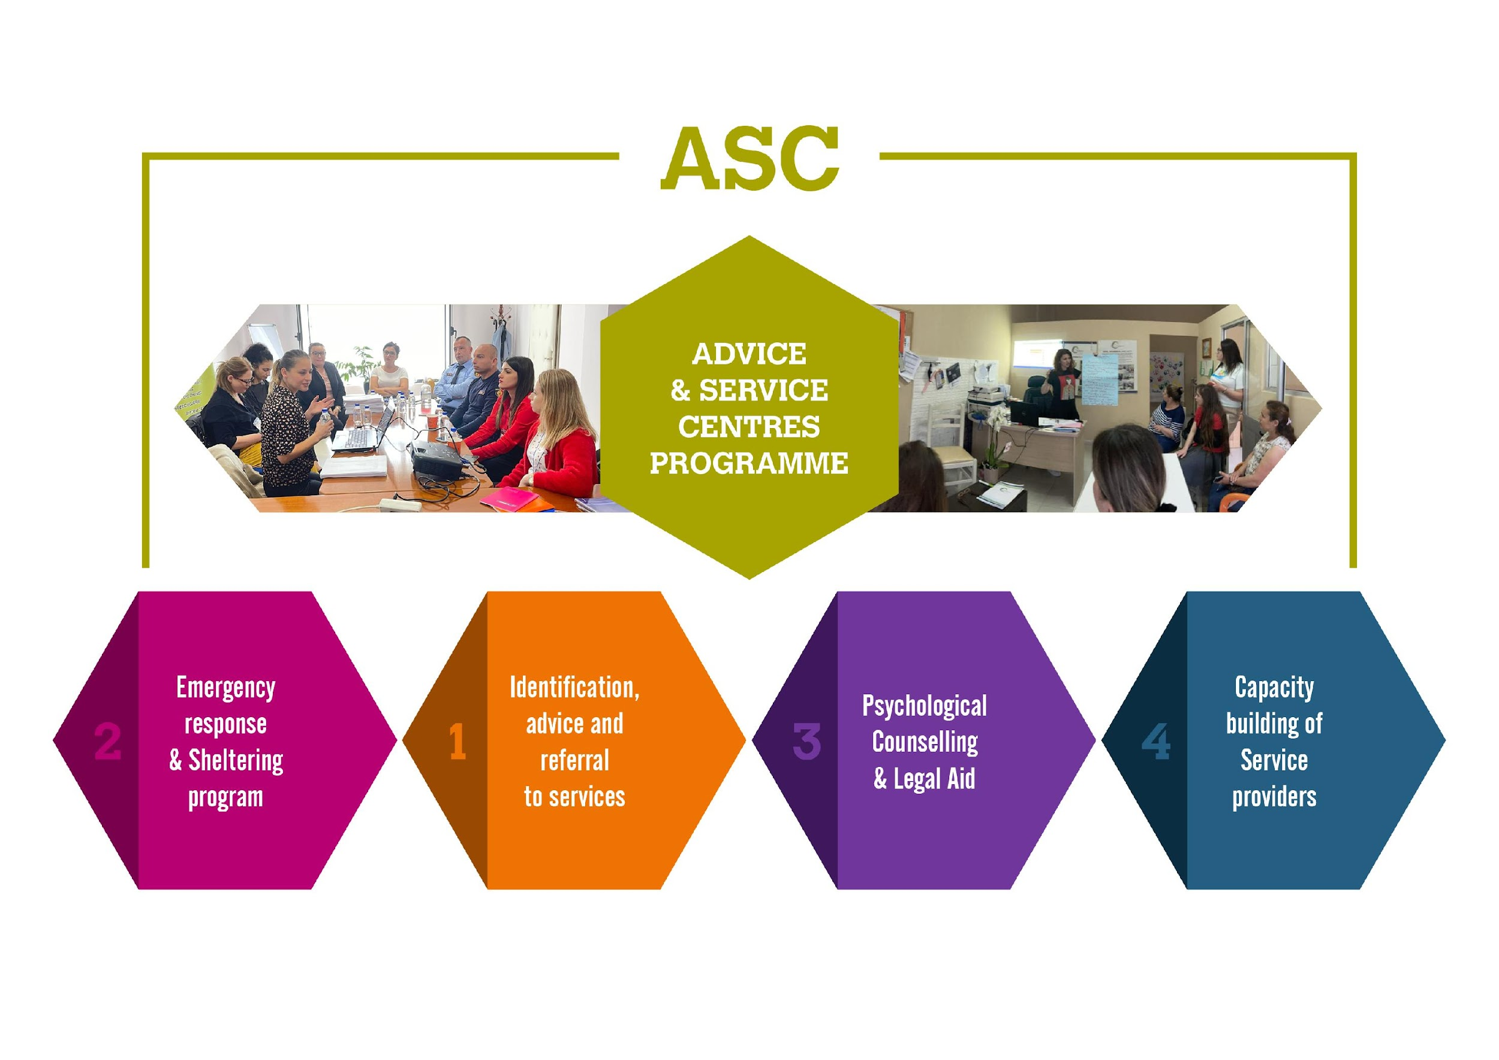
MARY WARD LORETO

Slide 10
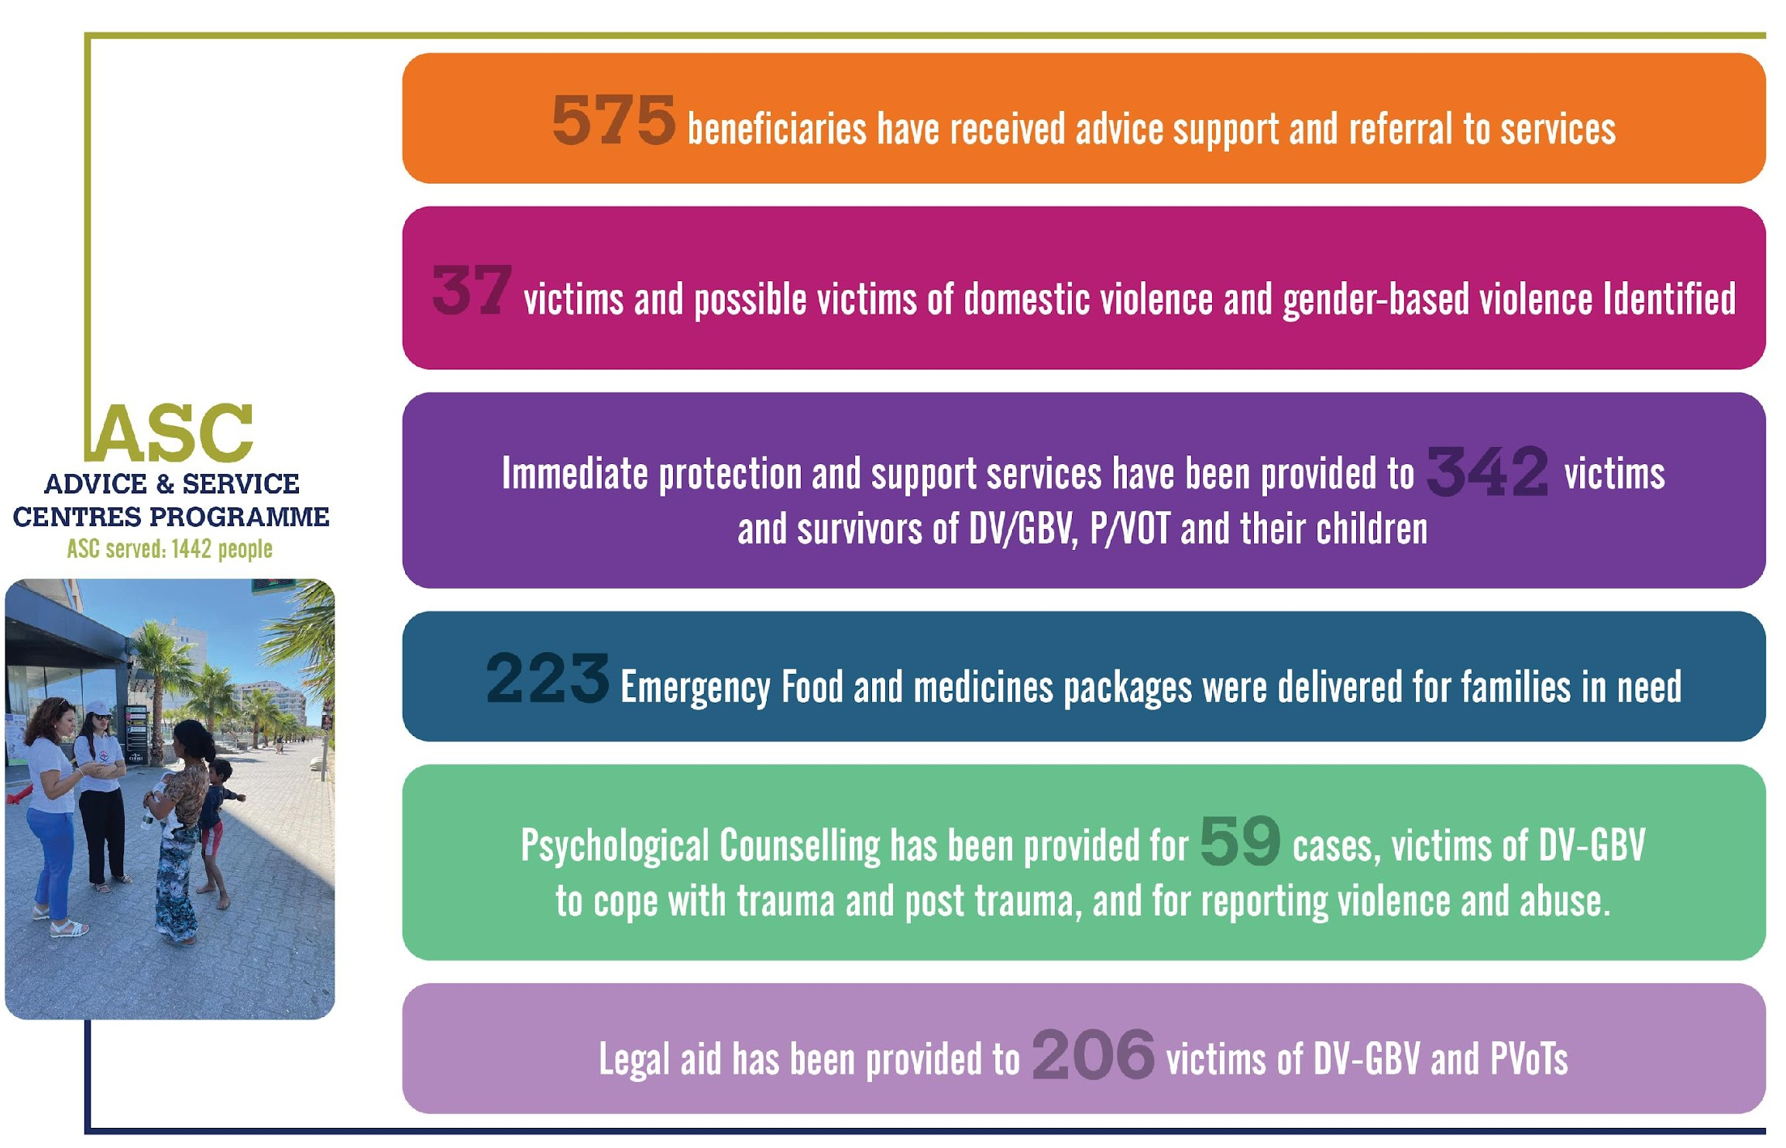
Mary Ward Loreto

Slide 11
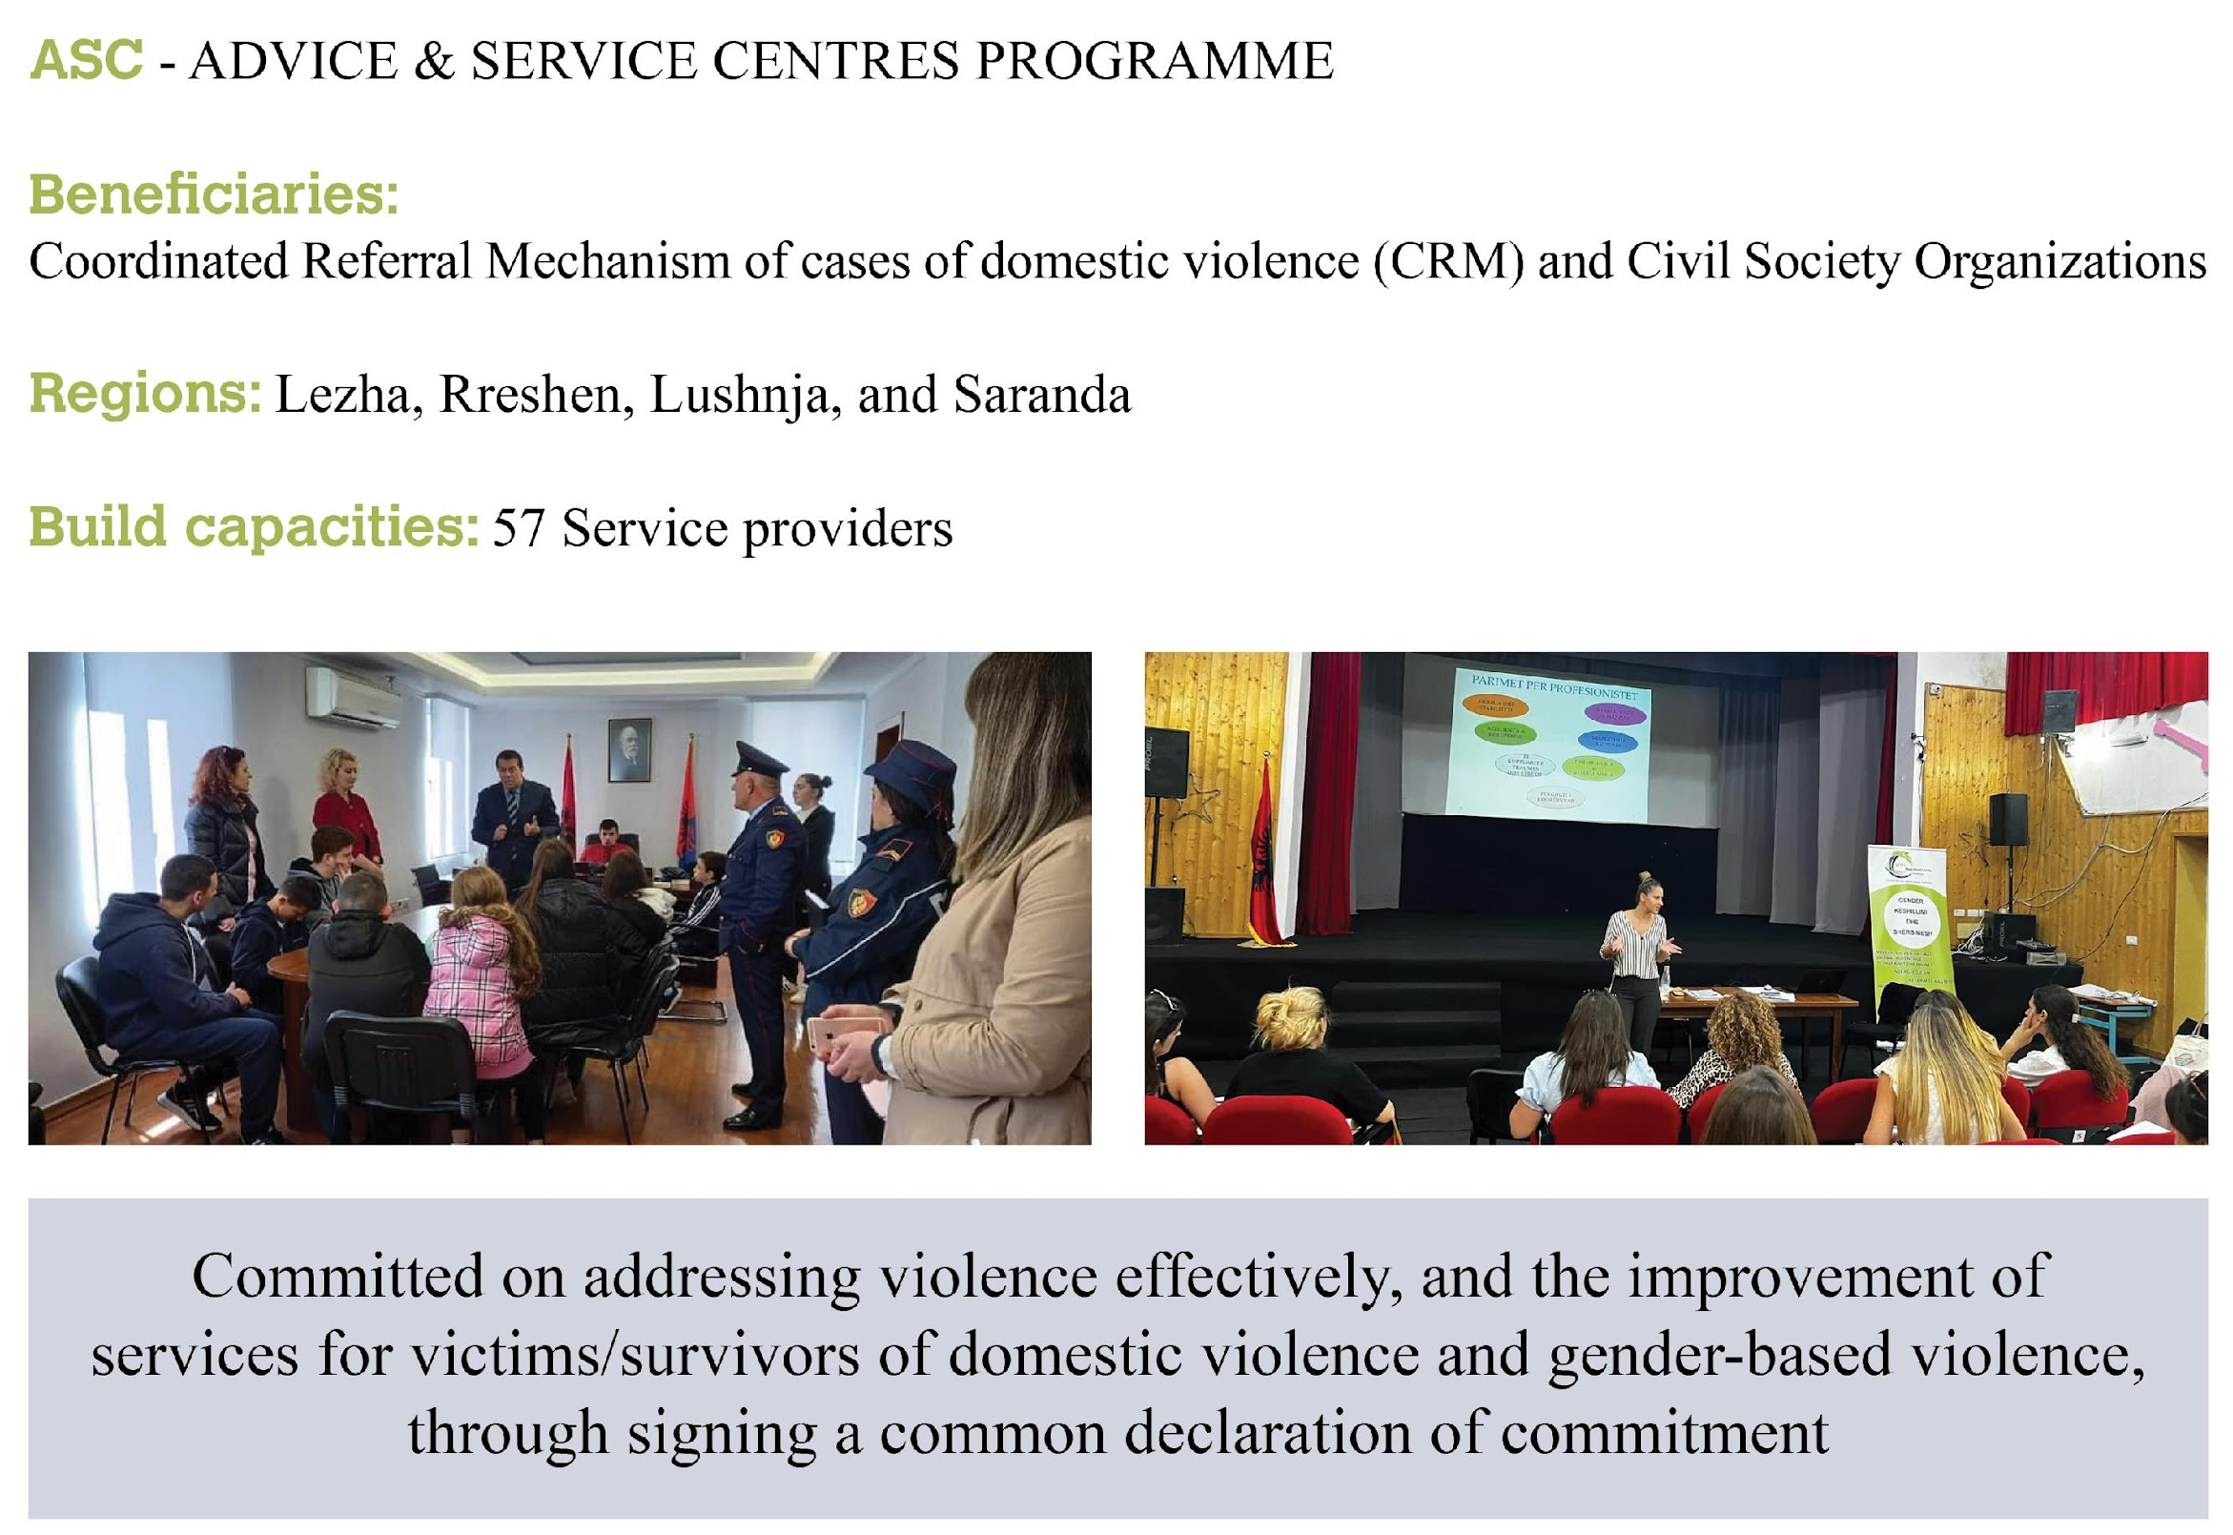
MARY WARD LORETO

Slide 12
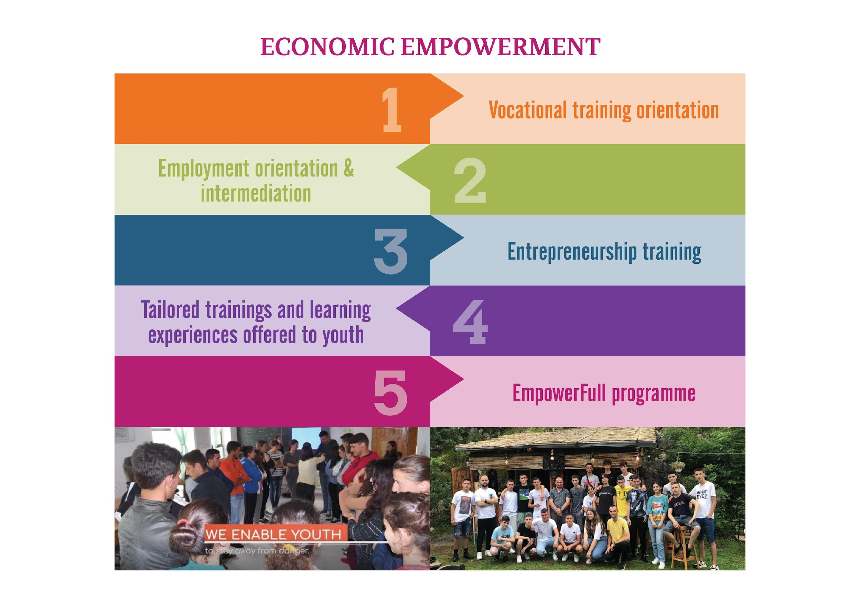
MARY WARD LORETO

Slide 13
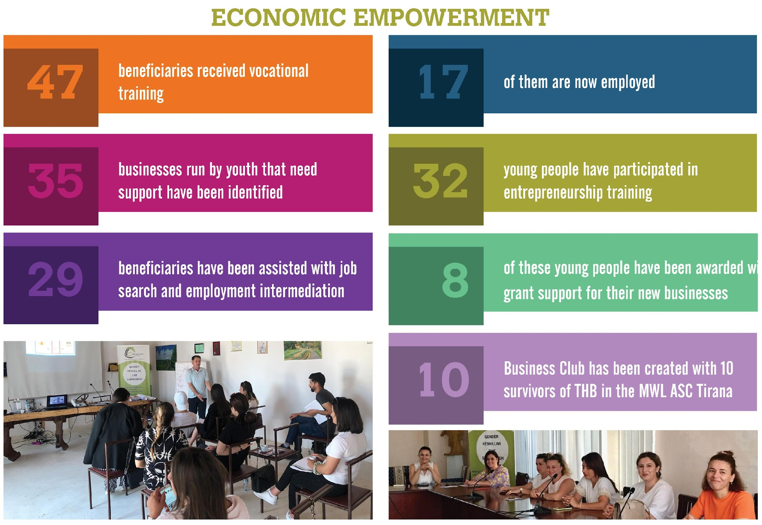
MARY WARD LORETO

Slide 14
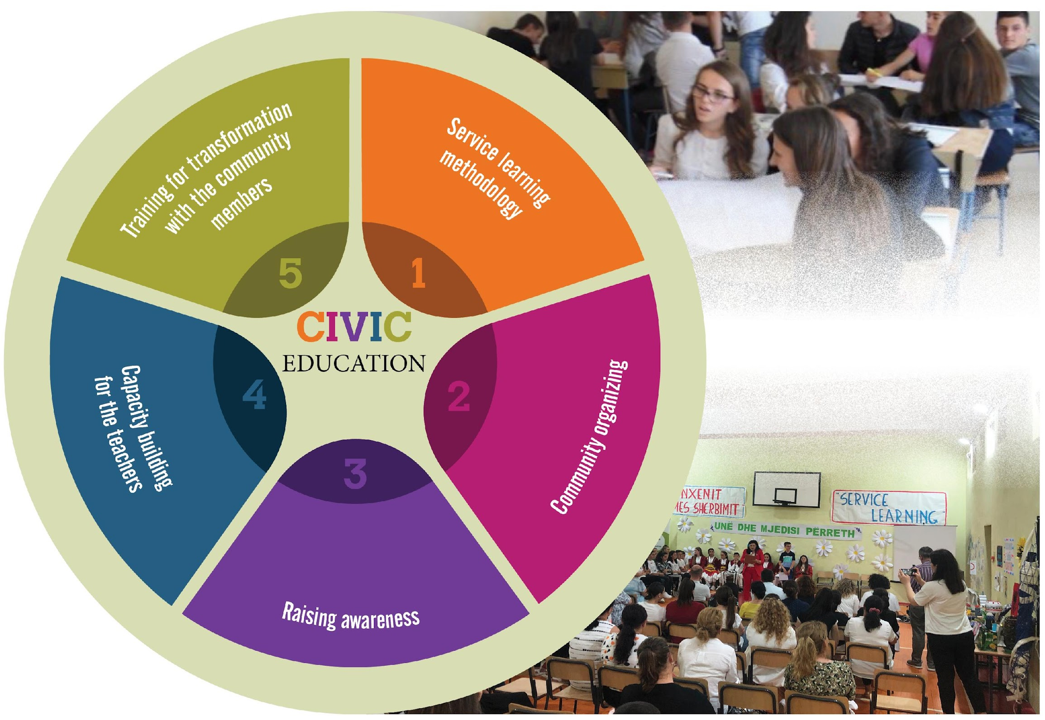
MARY WARD LORETO

Slide 15
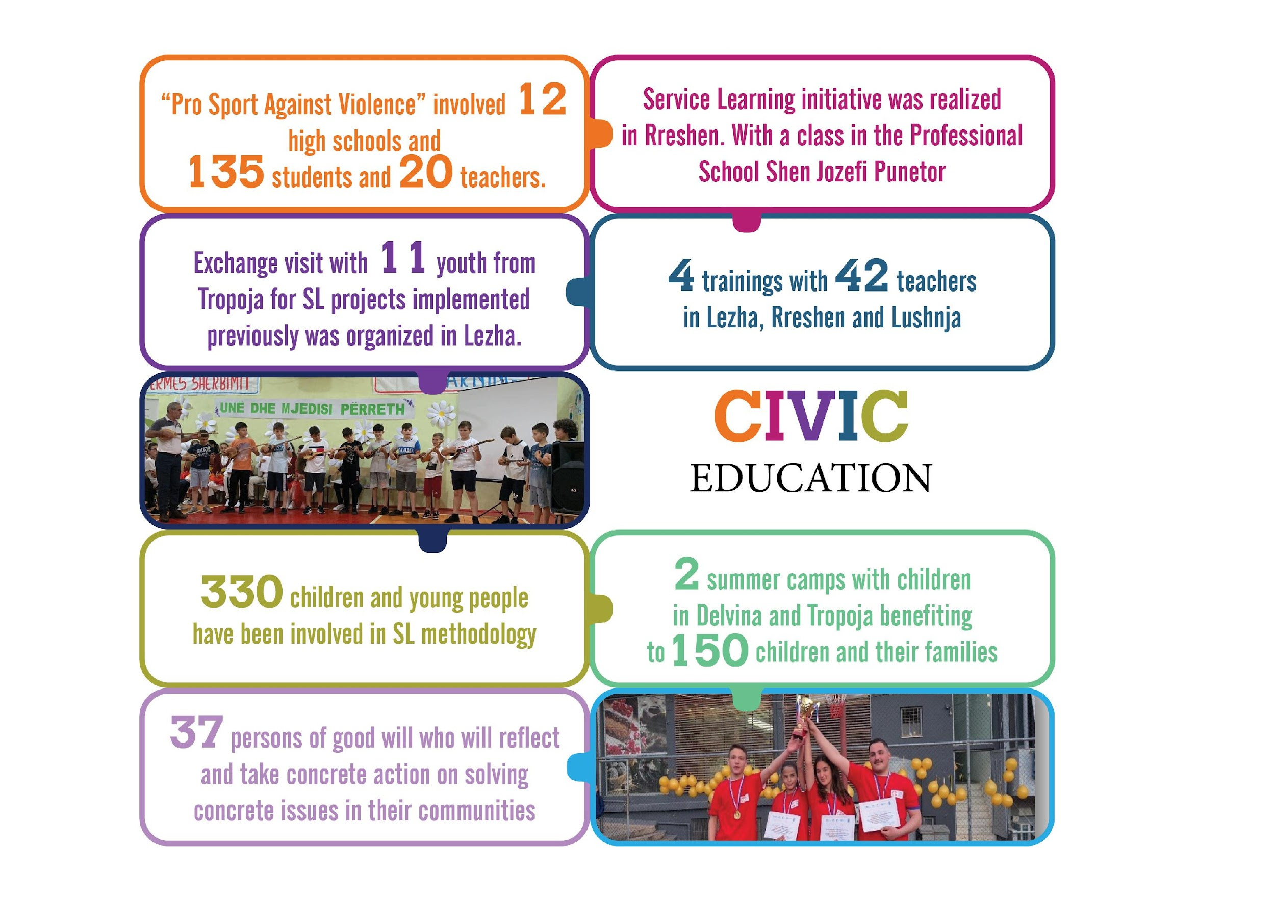
MARY WARD LORETO

Slide 16
Outputs
Services, referrals and accompaniment provided – 2,334.
Delivery of vocational training – 189 Participants.
Delivery of support for the development of youth-owned businesses and start-ups – 113 trained.
Meetings and awareness sessions conducted with industries/ businesses – 14.
Workshops and training delivered to local officials – 107 officials trained.
Training in service learning, leadership and social transformation – 330 young people trained.
291 non-Albanian migrants had a needs assessment.
  5 Focus Groups were developed with migrants, respectively:
    3 Focus Groups with men (74 participants) and
    2 with women (42 participants) on raising awareness against human trafficking and exploitation
MARY WARD LORETO

Slide 17
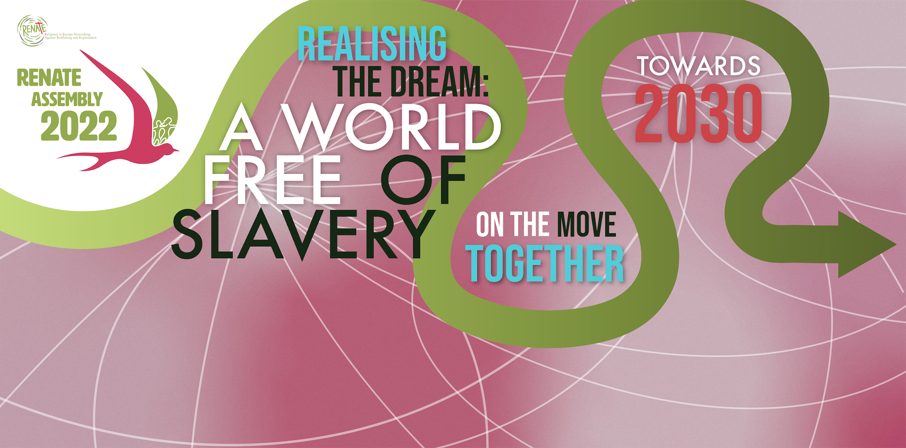

“Human trafficking is violence! The violence suffered by every woman and every girl
is an open wound in the body of Christ, in the body of all humanity,
it is a deep wound that also affects each one of us.”
Pope Francis February 8th 2022, Feast of St Bakhita

Slide 18
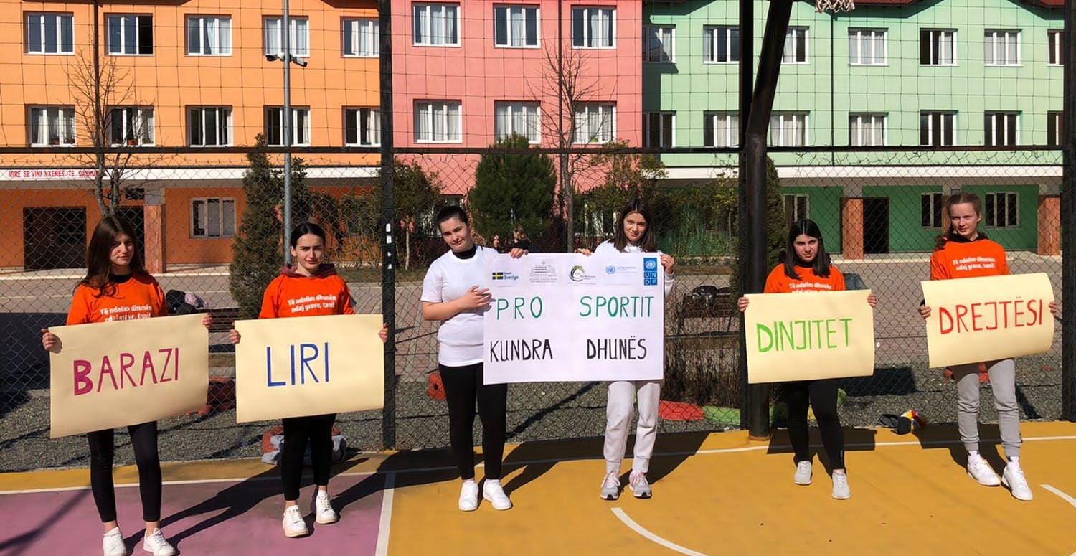
Thank you!
FREEDOM JUSTICE SINCERITY

