Slide 1

Ensuring Victim-Centred and Trauma-Informed Support in Displacement Contexts
Natalia Holynska,
Caritas Ukraine
Regional Conference: “Enhancing Cross-Border Cooperation of National Referral
Mechanisms to Address Trafficking in Persons in Contexts of Displacement
and Mixed Migration Flows”
November, 2025

Slide 2
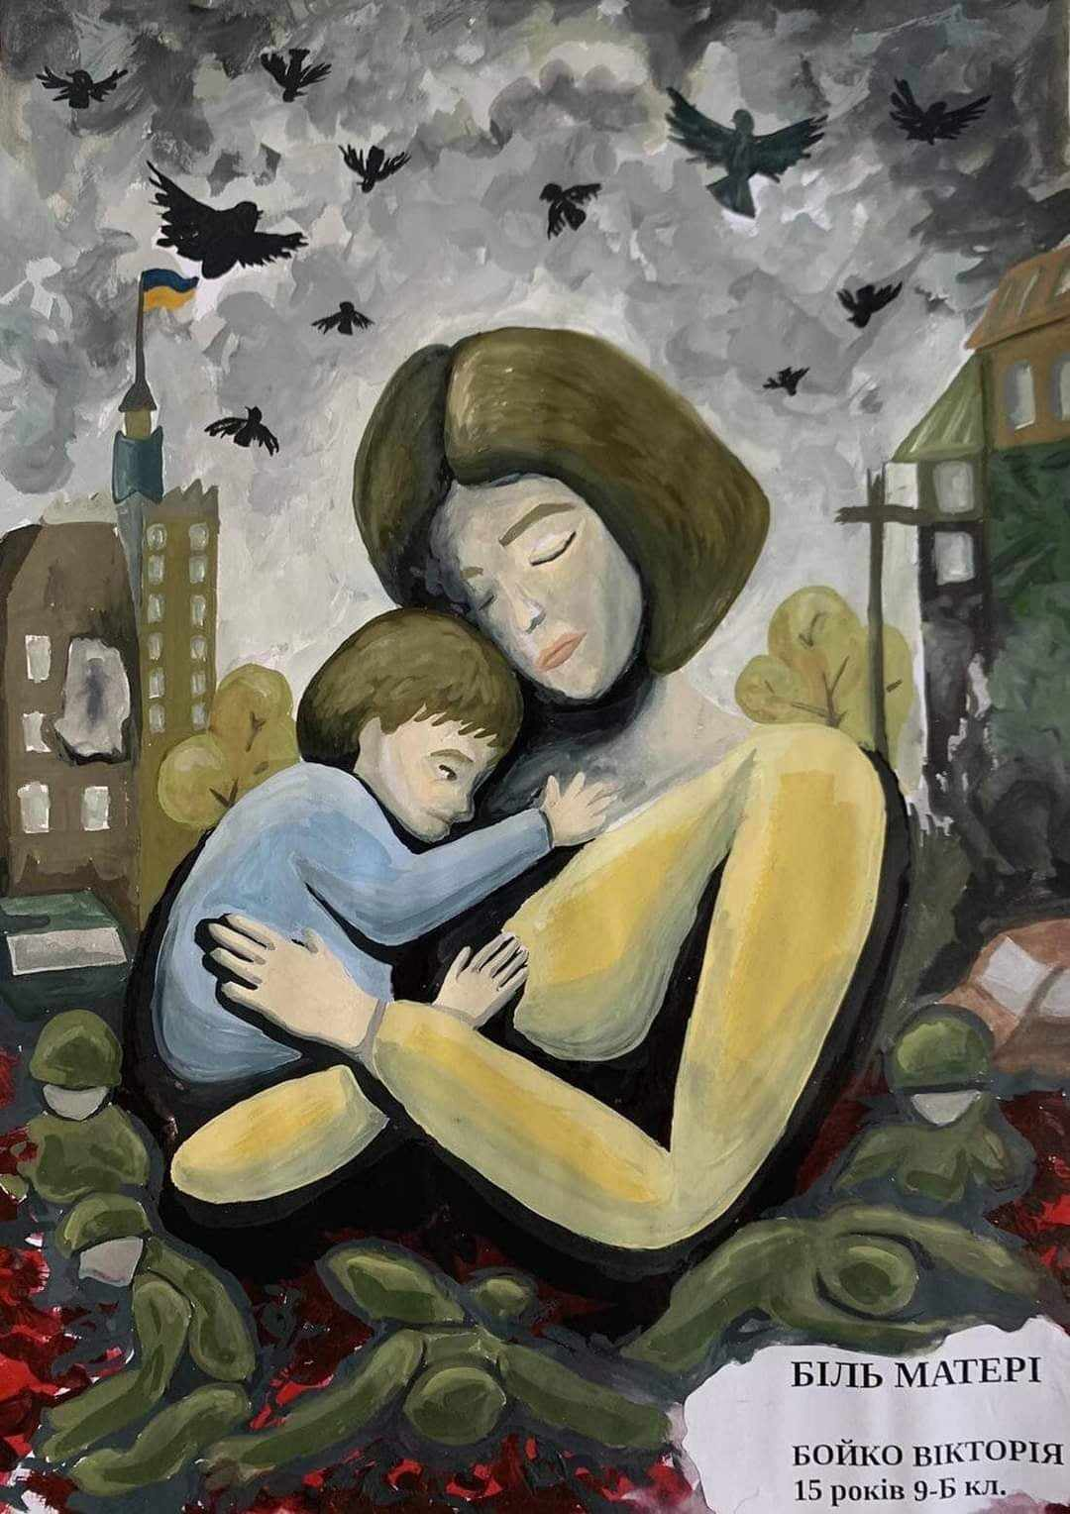
Situation in Ukraine
KEY NUMBERS 2025*:
People in need - 12.7 million
Of them:
Children - 12%
Older people - 30%
People with disability - 14%
*Data Sources: UNHCR Operational Data Portal, November 2024; Ukraine Humanitarian Needs and Response Plan 2025 (UN OCHA); HRMMU Protection of Civilians in Armed Conflict, October 2024.
16.3 M - (1 out of 2) people chronically affected by the war
Of them:
12.6 M - (1 out of 3) non-displaced
people chronically affected by the war
3.6 M people internally displaced
6.8 M refugees from Ukraine,
92% of them in Europe
Verified civilian casualties (2022 - Jan 2024) 39,000 !

Slide 3
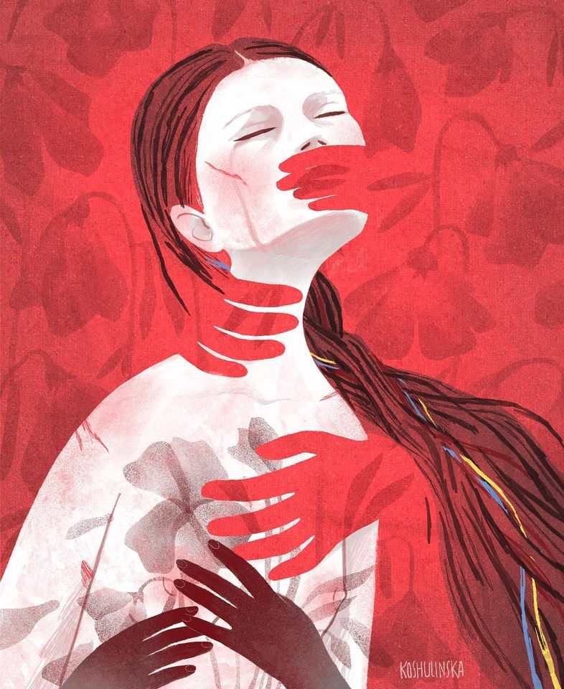
Impact of ongoing war
Only 2 % of the most vulnerable displaced population are housed in nearly 1,800 collective sites across 23 oblasts and the city of Kyiv
82 % of IDPs have been displaced for more than a year, having fled their homes during the first year of the full-scale war with no viable prospects for return in the foreseeable future.
Trauma and psychological distress due to constant uncertainty, fear of attacks, grave protection risks and serious mental health problems; 63 % of households reporting at least one form of mental health challenge.
Children are particularly vulnerable, with an estimated 1.5 million children at risk of posttraumatic stress disorder (PTSD), depression and other mental health issues.

Slide 4
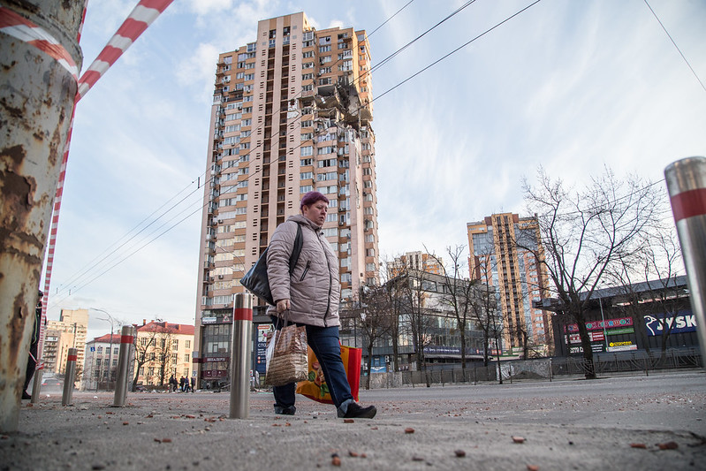
Vulnerability of the society
The number of people living in poverty has increased up to over 9 million
Coping mechanisms have been depleted and expenditures on health, education and other critical basic services are compromised.
Nearly 60 % of assessed households identified livelihood needs as their highest priority, especially in front-line areas and along the border with russia.
Median reported monthly household income per household member is 6 667 UAH (135 Є).
Since the beginning of the full-scale war, the average life expectancy of Ukrainians has decreased by 10 years.
Average life expectancy of Ukrainian men is 57,3

Slide 5
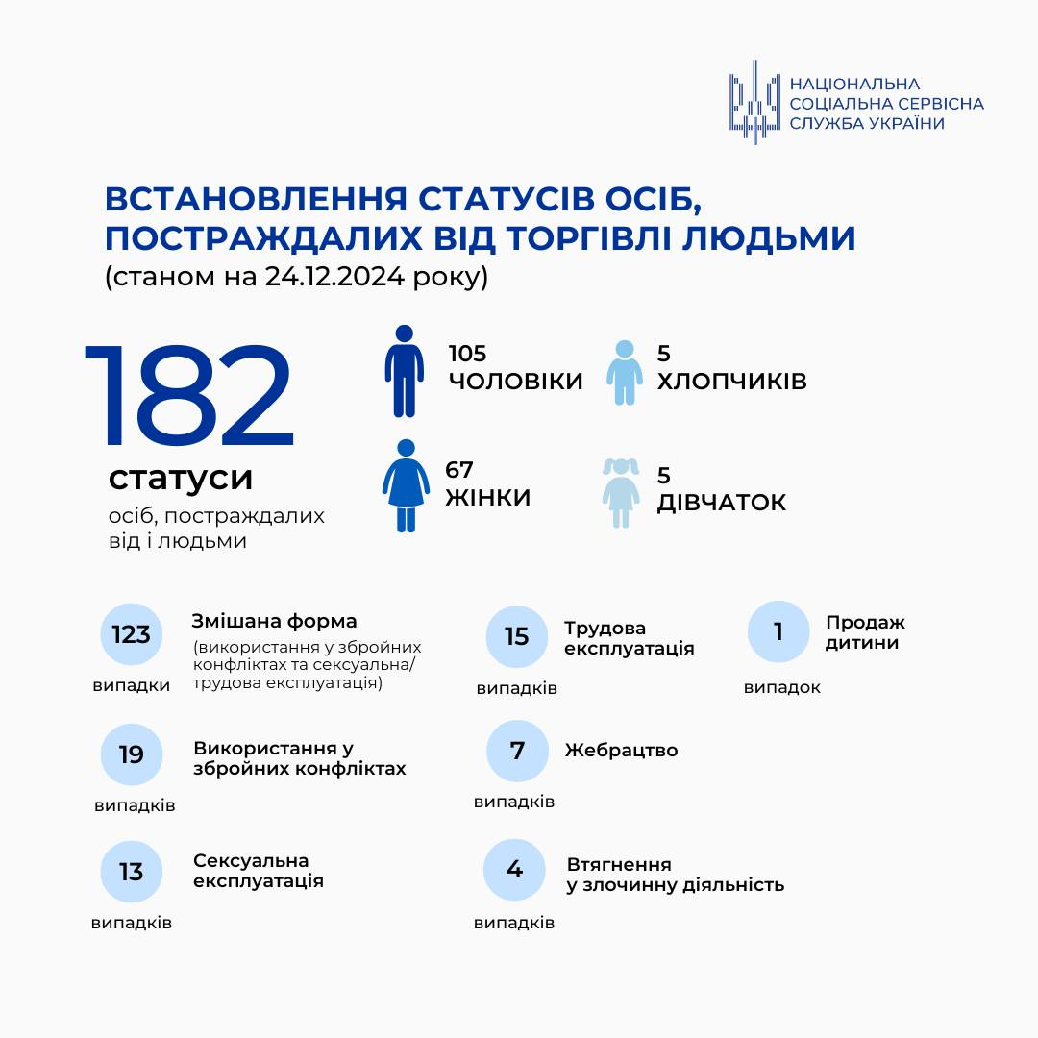
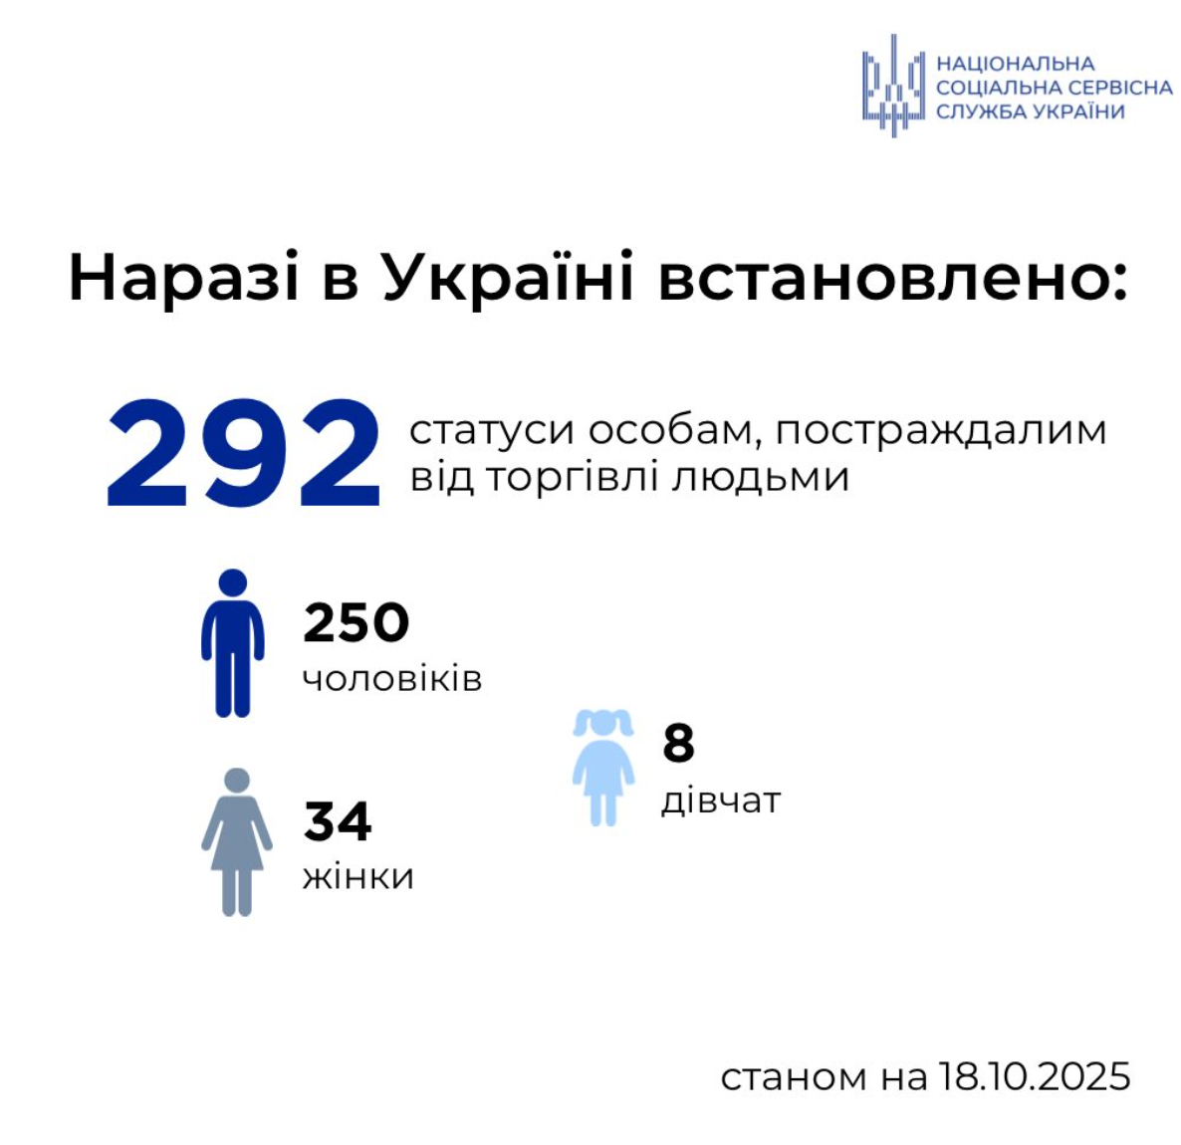
Human trafficking in the context of war
In 2024 – 182 identified survivors. October 2025 – 292!

Slide 6
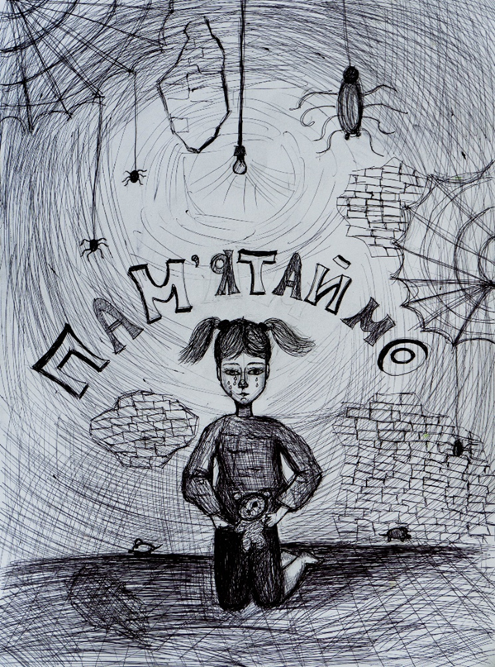
Tendencies in human trafficking in Ukraine
More than 70% of the victims of trafficking suffered from mixed forms of exploitation, often while in captivity or civilian hostages. Many were subjected to sexual exploitation, forced labor, domestic servitude, or coerced into participation in the conflict.
Majority of all officially identified victims are men (85%);
The rising of child trafficking, directly linked to the ongoing war. According to Caritas Ukraine, approximately 10% of all screened survivors are children;
Increasing of online exploitation or/and recruiting, using of AI for cyber trafficking;
385 cases of conflict-related sexual violence (CRSV) have already been recorded, 23 victims are children!

Slide 7
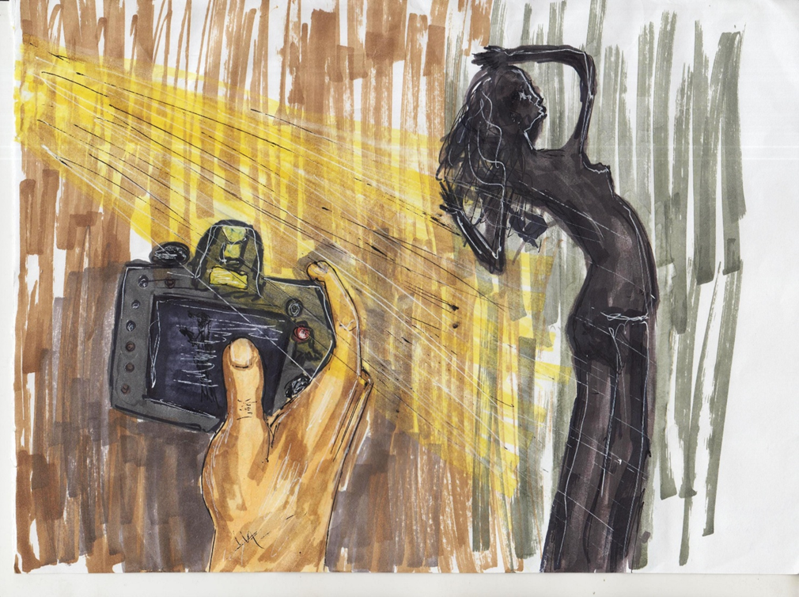
Respond of Caritas Ukraine
Proactive screening and identification of trafficking victims, not only for sexual exploitation but also for labor exploitation, cyber-crimes, online scams, domestic servitude, criminal activity, and mixed forms of exploitation;
Practicing culturally sensitive and trauma-informed strategies for victim identification, referral, and protection;
Raising awareness about online scams, cyber trafficking, surrogacy-related risks, use/misuse of technologies, risks, safety considerations & protection measures necessary when using AI;
Enhancing NRM and improvement of international referral mechanisms and cross-border cooperation to address human trafficking and support of survivors.

Slide 8
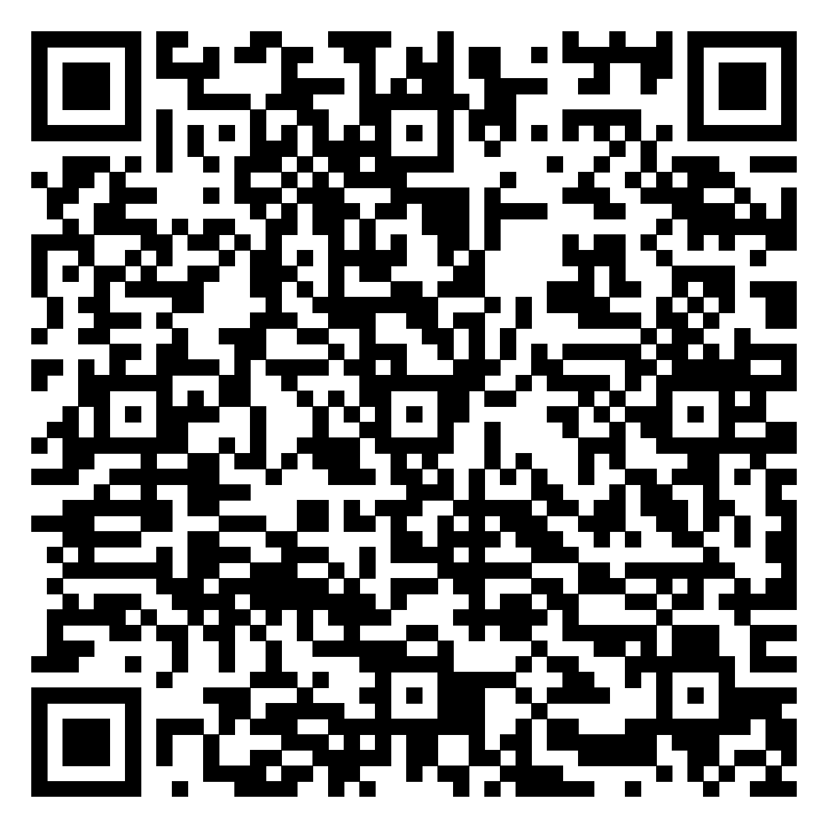
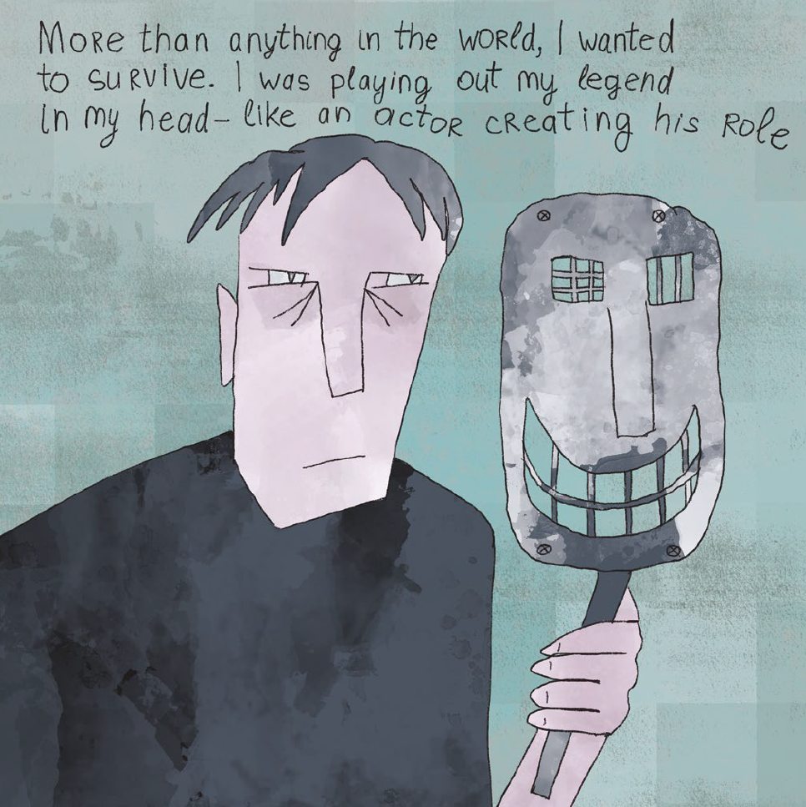
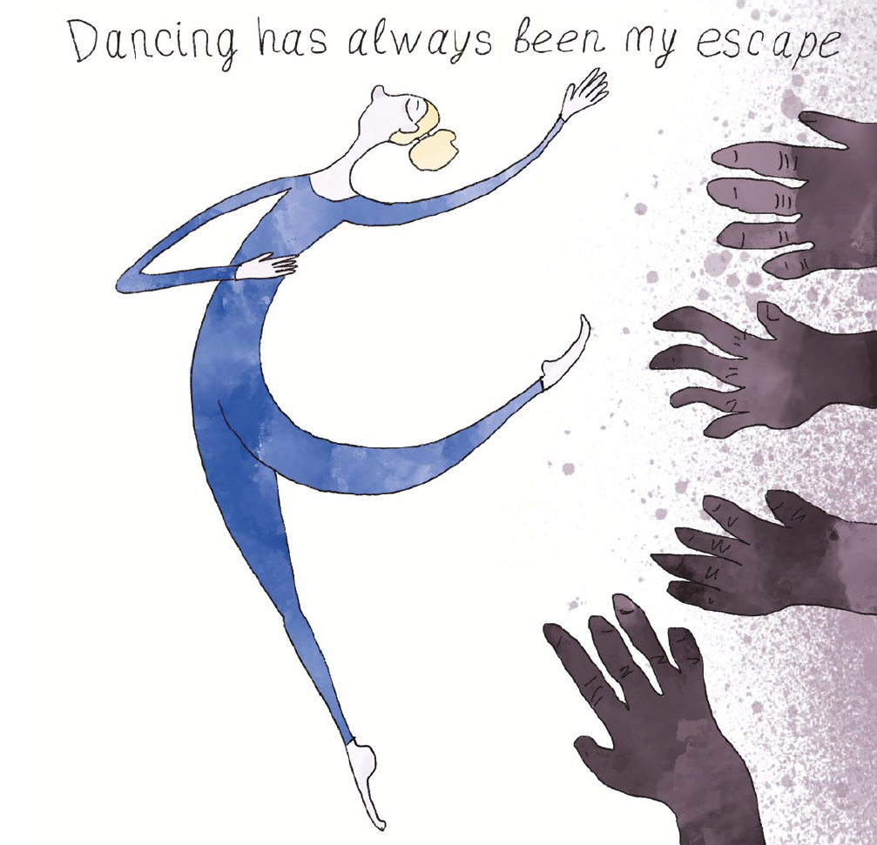
Caritas Ukraine’s advocacy for protection of survivors
The book of stories of Ukrainians who suffered from human trafficking during the war «Fragile Life» was edited

Slide 9
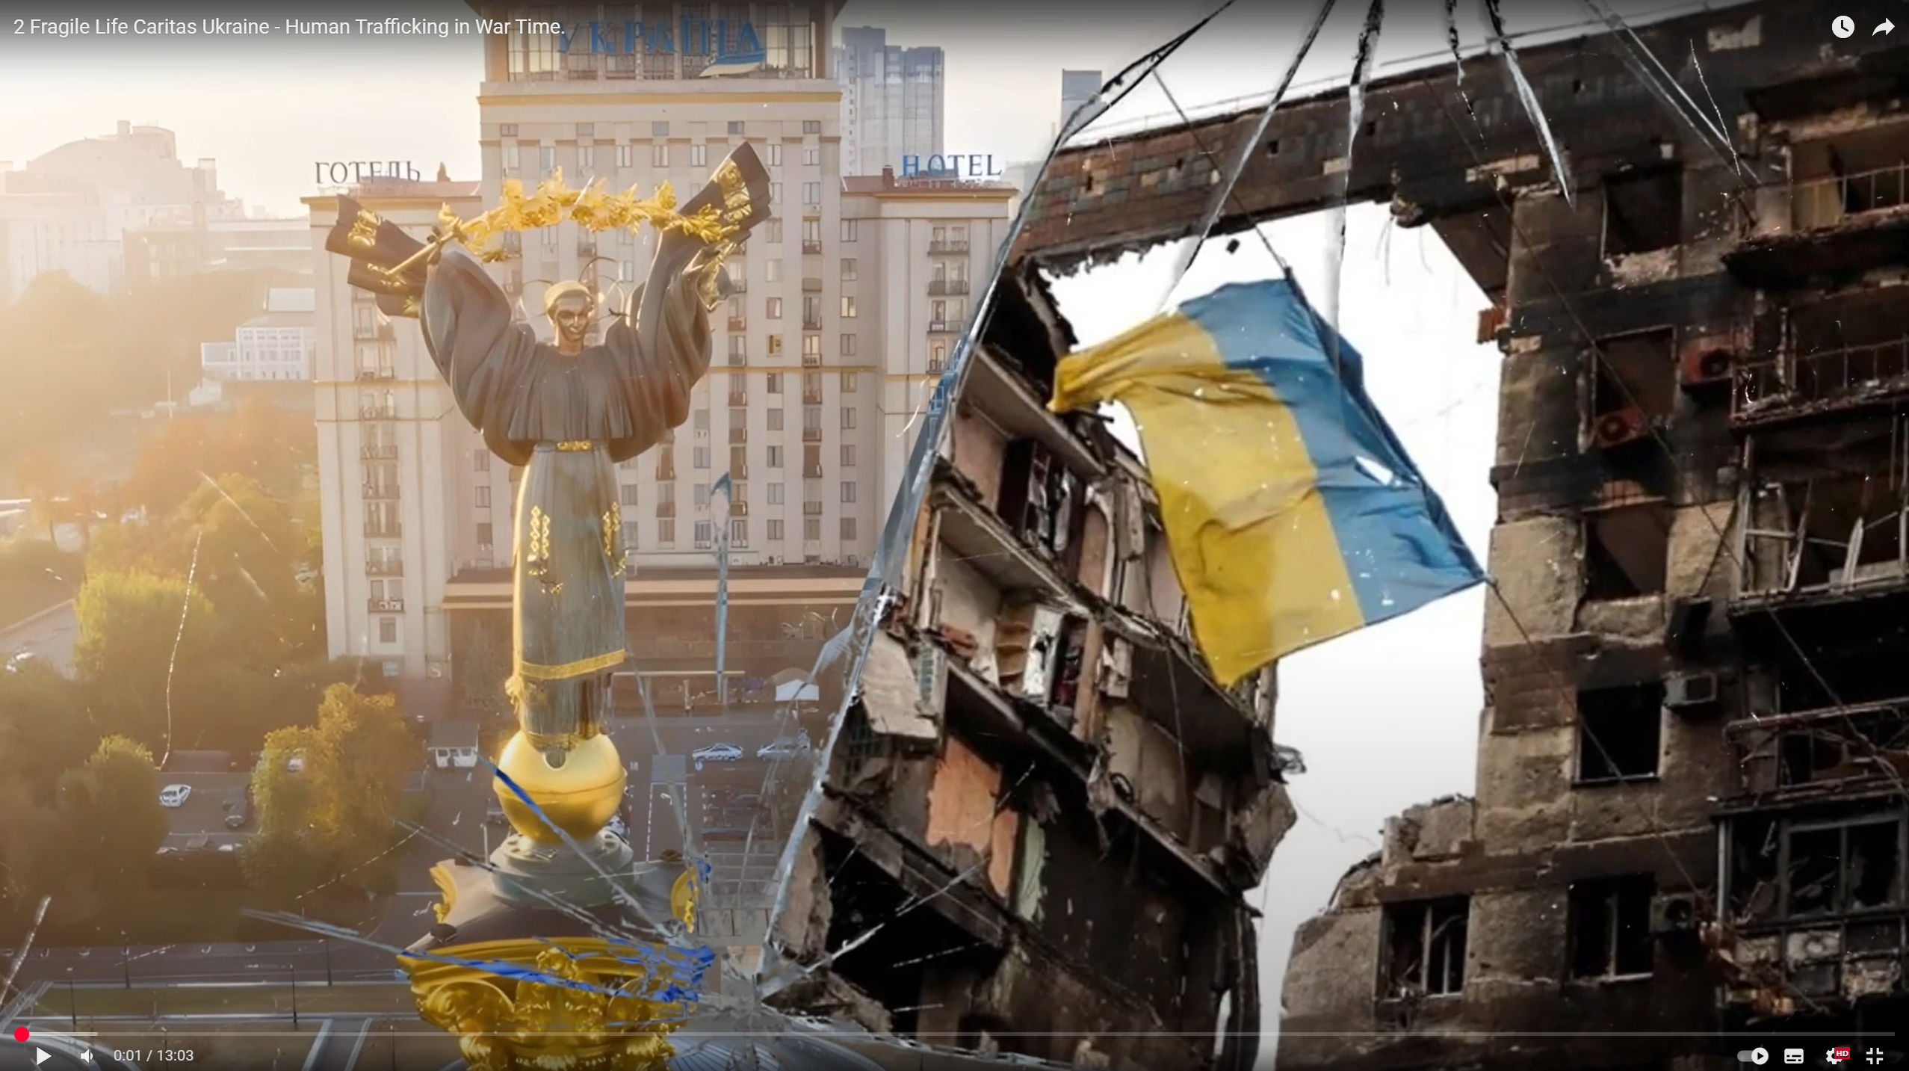
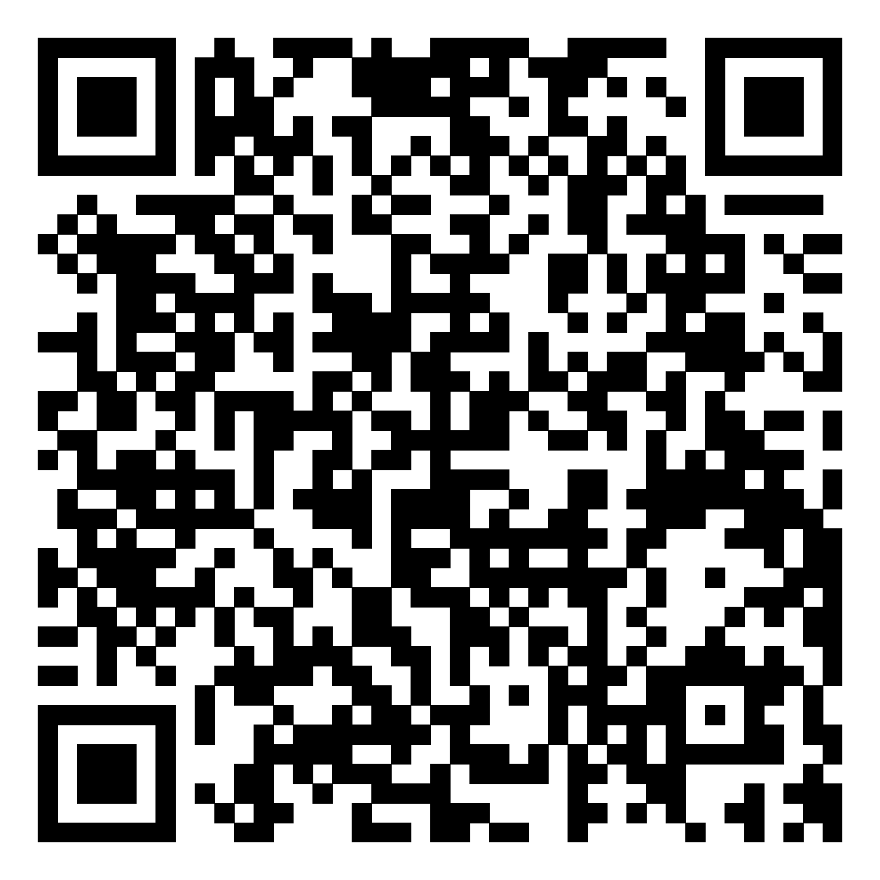
Docudrama “Fragile Life” by Caritas Ukraine.
Human Trafficking in War Time

Slide 10
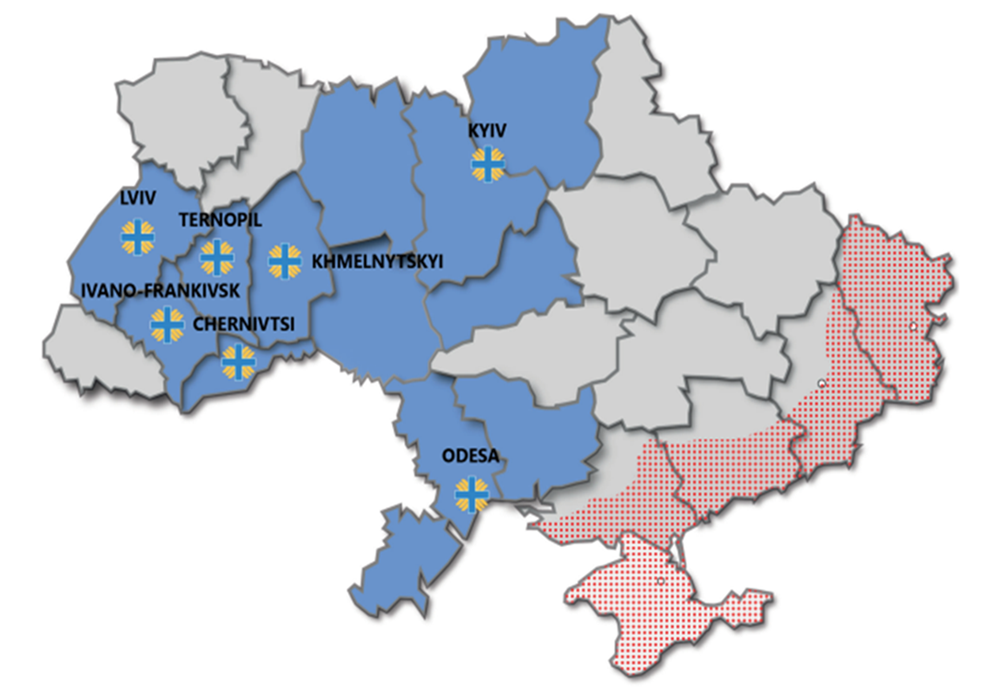
Results of Caritas Ukraine’s counter trafficking activities (2024-2025)
7 centers covering 12 regions of Ukraine with anti-trafficking work from January 2024 to October 2025 preliminary identified 327 survivors and 120 potential victims
64% of our beneficiaries are female
26% - male
10% - children
60% of them are IDPs
14% are disabled people
Majority of cases are internal trafficking for labor or sexual exploitation, involving into war conflict or mixed types of exploitation.

Slide 11


Cross border cooperation
(Ukraine, Romania, Moldova)
To address trafficking in persons in contexts of displacement and mixed migration flows Caritas Ukraine in 2025 started the new project. The main aim of it is strengthening cooperation between Caritas Ukraine, Caritas Romania and Caritas Moldova to mitigate the negative effects of the war on the vulnerable population of Ukraine in transit and reduce the negative trends of human trafficking in Ukraine, Romania and Moldova.
Due to the preliminary results of Caritas survey of Ukrainian refugees living in Moldova and Romania
- 50,5 % of all the responders don’t plan to return to Ukraine in the coming period of time.
- 31,6 % of them don’t know or are not sure.
- 14,7 % would return within the next six months if the situation in Ukraine allows.
The most important reasons to return to Ukraine are
- family reunification,
- economic hardship in host countries,
- children’s education needs.

Slide 12
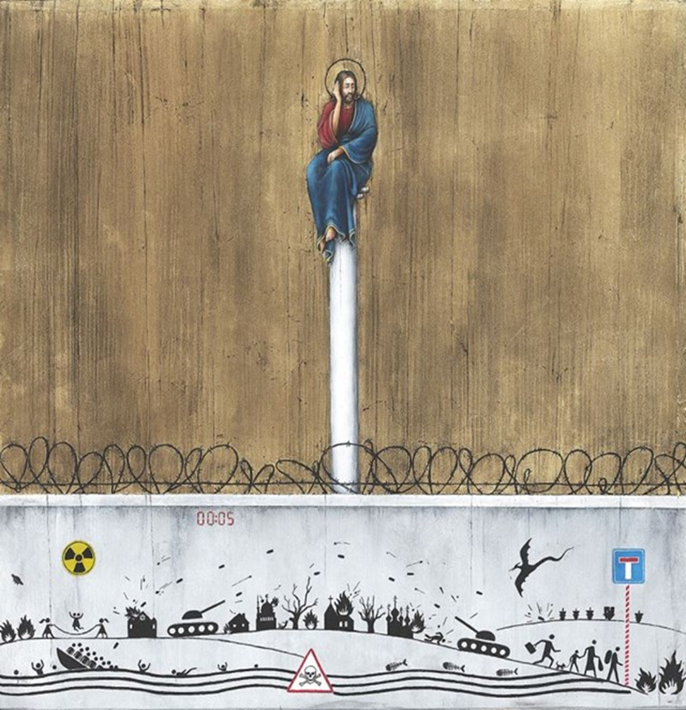
Conclusions and recommendations
Strengthening cross-border cooperation especially with Ukraine;
Involving different stakeholders in proactive screening of potential victims and their effective cross-border referral and protection;
Strengthening capacities and trainings of border police for better screening of the victims;
Capacity building of NRM in SEE countries;
Developing new strategies of transnational referrals.
Ensuring victim-centered and trauma –informed approach of all stakeholders in the work with survivors of human trafficking.

Slide 13

Thank you!
More about our work -
https://programs.caritas.ua/programs/safe-migration-and-combating-human-trafficking/
nholynska@caritas.ua

