Slide 1
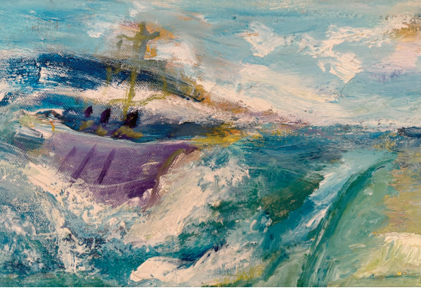
Opening Prayer
Philippians 2:10-11
At the name of Jesus, every knee shall bend,
those in heaven and those on earth and under the earth,
and every tongue confess that Jesus Christ is Lord,
to the glory of God, the Father.
Dear God,
We come before You with hope, yet sad at the plight of so many. We have heavy hearts, and seek Your guidance and strength in the fight against human trafficking. We lift up all those who are trapped in this terrible injustice, those who suffer in silence and fear. We ask that You wrap them in Your love and protection, bringing them hope and a path to freedom.

Slide 2
Lord, grant wisdom and courage to those who work to rescue and support victims.
At this time in October, when we remember so many involved in this mission, we pray you will empower law enforcement, social workers,
and advocates to recognize the signs of trafficking and respond with compassion and urgency. Help us all to be vigilant and proactive in our communities,
standing against exploitation in all its forms.

Slide 3
We pray for healing for those who have endured unimaginable pain and suffering. May they find solace and support as they rebuild their lives, and may they feel Your presence in their darkest moments.
Lord, we ask for a transformation of hearts and minds, that society may come to value the dignity and worth of every individual. Inspire a collective commitment to justice, leading us to work together to eradicate this pervasive evil.
In Your holy name, we pray for freedom, restoration, and a world where all can live in safety and dignity.
Amen.

